Slide 1

Note: The data and information in this document is reflective of a hypothetical situation and client. This document is to be used for KPMG Virtual Internship purposes only.
Sprocket Central Pty Ltd
Data analytics approach
[Division Name] - [Engagement Manager], [Senior Consultant], [Junior Consultant]

Slide 2
Note: The data and information in this document is reflective of a hypothetical situation and client. This document is to be used for KPMG Virtual Internship purposes only.
Agenda
Introduction
Data Exploration
Model Development
Interpretation

Slide 3
Note: The data and information in this document is reflective of a hypothetical situation and client. This document is to be used for KPMG Virtual Internship purposes only.
Introduction
Customer Analytics
Age & Gender
Number of Bikes Purchases within the last three years
Job Category
Wealth Class
Car’s Ownership
Customer Locations
Brand and Product Sizes

Slide 4
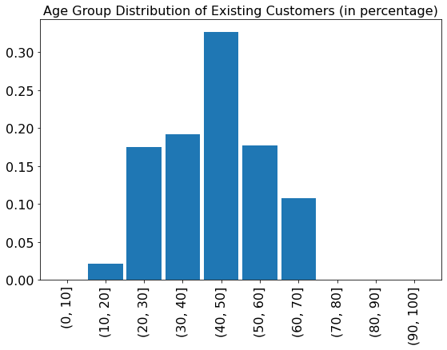
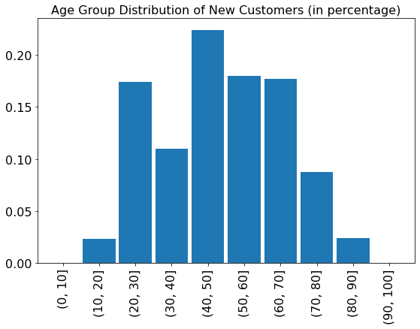
Note: The data and information in this document is reflective of a hypothetical situation and client. This document is to be used for KPMG Virtual Internship purposes only.
Data Exploration
Age Distribution
Compared with existing customers with majority in the ages between 48 and 59, there are more younger ones in the new customer group with age between 25 and 48.
This indicates that the firm should consider the future’s marketing strategies focus more on all-aged customers instead of solely on middle aged ones.

Slide 5
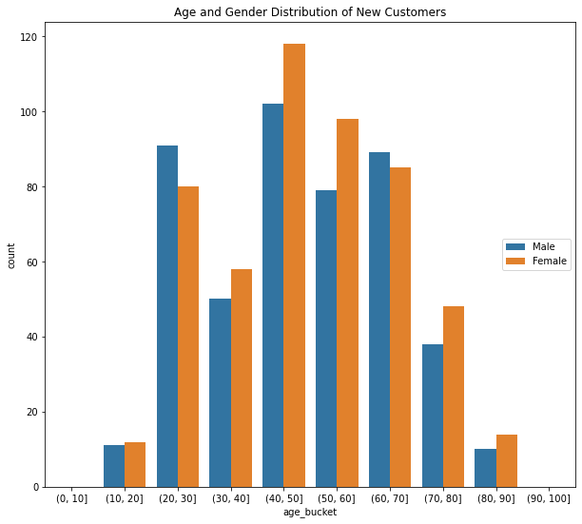
Note: The data and information in this document is reflective of a hypothetical situation and client. This document is to be used for KPMG Virtual Internship purposes only.
Data Exploration
Age & Gender Distribution
In both groups of existing and new customers, there are more females than males.
For New Customers, except the age ranges in 20 – 30 and 60 – 70, customers in other ages are having more females than males.
This indicates that the marketing activities toward the new customers could more focus on the female group.

Slide 6
Note: The data and information in this document is reflective of a hypothetical situation and client. This document is to be used for KPMG Virtual Internship purposes only.
Data Exploration
Number of Bikes Purchases within the last three years
From the mean values of the past 3 years bike related purchases grouped by Gender and their Age groups in existing customers, we can find that male customers have higher purchase frequencies than female customers, especially in the middle age groups.
This shows that we could consider to deploy more marketing activities to enhance the new customers' loyalty in this group and increase their re-purchase chances in the future times.

Slide 7
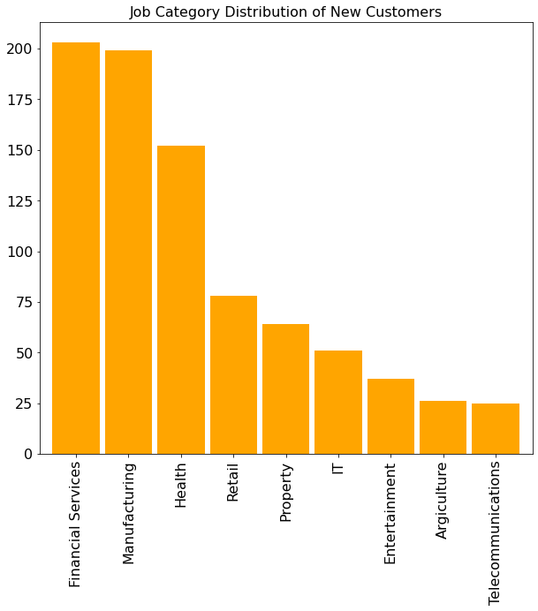
Note: The data and information in this document is reflective of a hypothetical situation and client. This document is to be used for KPMG Virtual Internship purposes only.
Data Exploration
Job Category
The top 3 categories of the New Customers are in Manufacturing, Financial Services and Health.
Therefore, it could be a good idea to focus the marketing campaign and strategies toward these industries.

Slide 8
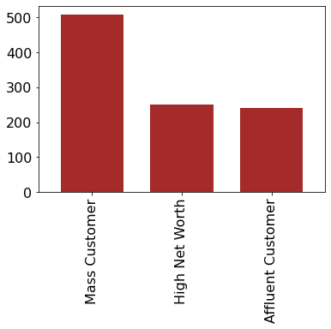
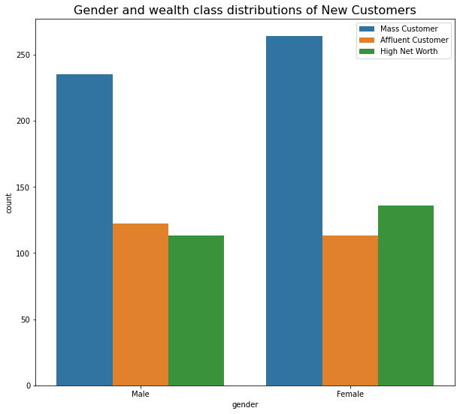
Note: The data and information in this document is reflective of a hypothetical situation and client. This document is to be used for KPMG Virtual Internship purposes only.
Data Exploration
Wealth Segments
Most customers are in the Mass Segment, which should be at the most focus of the marketing campaigns
For the perspective of Genders, the rank of wealth segments for Males are Mass, Affluent and High Net Worth; the rank of wealth segments for Females are Mass, High Net Worth and Affluent. This could guild the target marketing activities for the firm.

Slide 9
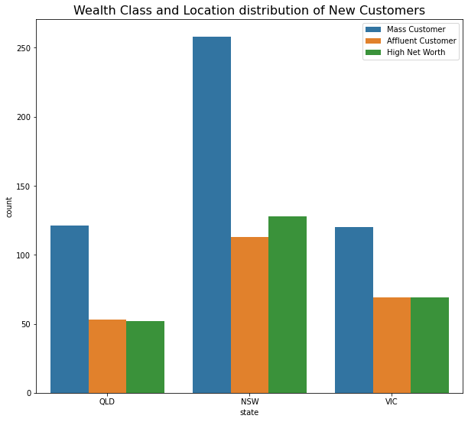
Note: The data and information in this document is reflective of a hypothetical situation and client. This document is to be used for KPMG Virtual Internship purposes only.
Data Exploration
Customer Locations
Most customers are in the the NSW state, followed by VIC and QLD.
More customers in the High Net Worth segment are at NSW than QLD and VIC
The firm should put more marketing efforts in the NSW market for Mass and High Net Worth customers who have more spending powers.

Slide 10
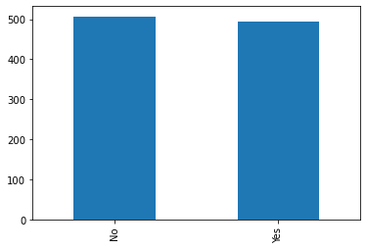
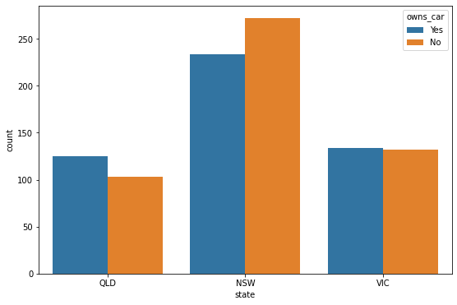
Note: The data and information in this document is reflective of a hypothetical situation and client. This document is to be used for KPMG Virtual Internship purposes only.
Data Exploration
Owns Car
Slightly more new customers do not have their car than those who have car(s).
In location level, there are more new customers do not have their car, while in the other states more customers have cars.

Slide 11
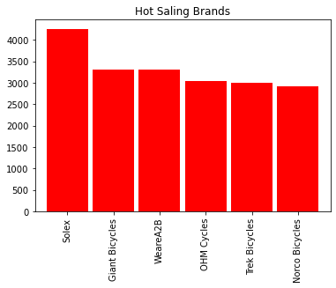
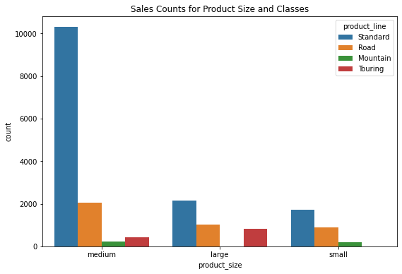
Note: The data and information in this document is reflective of a hypothetical situation and client. This document is to be used for KPMG Virtual Internship purposes only.
Data Exploration
Hot Sale Brands & Product Sizes and Classes
Solex is the most popular brand,
The majority of products sold are in Medium sized, with the Standard type in product line.
This shows the marketing team should focus more on the promotion of Medium sized and Standard type products to the new customers group.

Slide 12
Note: The data and information in this document is reflective of a hypothetical situation and client. This document is to be used for KPMG Virtual Internship purposes only.
Summary
The demographic of the new customers are different from the current customers.
Compared with current customers, the firm should consider to deploy marketing strategies to all-aged and more focus on female group in the new customers.
More marketing strategies could be designed to enhance the customer’s re-purchasing frequency and loyalty
More advertisements should be focus on the mass customers in financial services, manufacturing and health industries across Australia.
In the location perspective, most advertisement budget should be target at NSW market, followed by VIC and QLD states.
More promotions on Solex brand and focus at medium sized products could generate more sales

Slide 13
Note: The data and information in this document is reflective of a hypothetical situation and client. This document is to be used for KPMG Virtual Internship purposes only.
Appendix

Slide 14
Note: The data and information in this document is reflective of a hypothetical situation and client. This document is to be used for KPMG Virtual Internship purposes only.
Appendix
This is an optional slide where you may place any supporting items.

